Slide 1
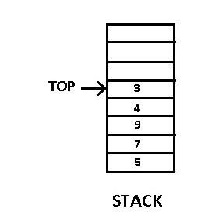
Stacks
A stack is an ordered collection of items where the addition of new items and the removal of existing items always takes place at the same end.
This end is commonly referred to as the “top”, and the opposite end is known as the “base”.
This feature makes it LIFO data structure. LIFO stands for Last-in-first-out. Here, the element which is placed (inserted or added) last, is accessed first.

Slide 2
Stack Operations
Basic operations performed in the stack:
Push: Adds an item in the stack. If the stack is full, then it is said to be an Overflow condition.
Pop: Removes an item from the stack. The items are popped in the reversed order in which they are pushed. If the stack is empty, then it is said to be an Underflow condition.
Peek or Top: Returns top element of stack.
isEmpty: Returns true if stack is empty, else false.

Slide 3
For example, if s is a newly-created, empty stack, then the table below shows the results of a sequence of stack operations. The top item is the one farthest to the right in “Stack contents”.
Stack operation Stack contents Return value
s.is_empty() [] True
s.push(4) [4]
s.push('dog') [4, 'dog']
s.peek() [4, 'dog'] 'dog'
s.push(True) [4, 'dog', True]
s.size() [4, 'dog', True] 3
s.is_empty() [4, 'dog', True] False
s.push(8.4) [4, 'dog', True, 8.4]
s.pop() [4, 'dog', True] 8.4
s.pop() [4, 'dog'] True
s.size() [4, 'dog'] 2

Slide 4
Applications of Stacks
Recursion
Evaluation of Expression (Infix to Postfix /Prefix conversion)
The simplest application of a stack is to reverse a word.
You push a given word to stack - letter by letter - and then pop letters from the stack.
Another application is an "undo" mechanism in text editors; this operation is accomplished by keeping all text changes in a stack.
Balancing of symbols
Redo-undo features at many places like editors, photo shop.
Forward and backward feature in web browsers
Used in many algorithms like Tower of Hanoi, tree traversals, stock span problem, histogram problem.
Other applications can be Backtracking, Knight tour problem, rat in a maze, N queen problem and sudoku solver
In Graph Algorithms like Topological Sorting and Strongly Connected Components

Slide 5
Example
Balancing of symbols
arithmetic expressions such as
(5+6)×(7+8)/(4+3)
where parentheses are used to order the performance of operations.
Balanced parentheses means that each opening symbol has a corresponding closing symbol and the pairs of parentheses are properly nested.

Slide 6
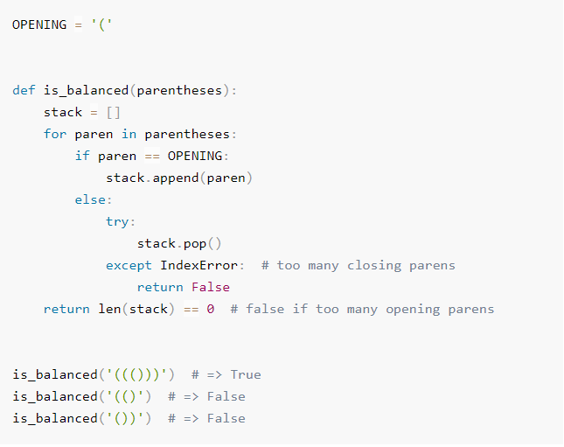
This function, is_balanced, returns a boolean result as to whether the string of parentheses is balanced. If the current symbol is (, then it’s pushed on the stack. If it is ) we attempt to pop from the stack. If the stack is empty at that point, we know that the parenthesis string is imbalanced with too many closing parens. Finally, as long as the expression is balanced and the stack has been completely cleaned off, the string represents a correctly balanced sequence of parentheses.

Slide 7
Recursion
Recursion simplifies the structure of many programs.
The process in which a function calls itself directly or indirectly is called recursion and the corresponding function is called as recursive function.
Example
Int function(int value)
{
if(value < 1) return;
function(value - 1);
printf("%d ",value);
}

Slide 8
A recursive function can go infinite like a loop. To avoid infinite running of recursive function, there are two properties that a recursive function must have −
Base criteria − There must be at least one base criteria or condition, such that, when this condition is met the function stops calling itself recursively.
Progressive approach − The recursive calls should progress in such a way that each time a recursive call is made it comes closer to the base criteria.

Slide 9
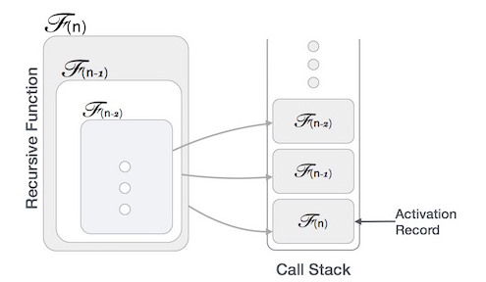
Recursion implemented by means of stacks. Generally, whenever a function calls another function or itself as callee, the caller function transfers execution control to the callee. This transfer process may also involve some data to be passed from the caller to the callee.

Slide 10
This implies, the caller function has to suspend its execution temporarily and resume later when the execution control returns from the callee function.
Here, the caller function needs to start exactly from the point of execution where it puts itself on hold.
It also needs the exact same data values it was working on.
For this purpose, an activation record (or stack frame) is created for the caller function.

Slide 11
Evaluation of Expressions
The way to write arithmetic expression is known as a notation.
An arithmetic expression can be written in three different but equivalent notations, i.e., without changing the essence or output of an expression.
Infix Notation: Operators are written between the operands they operate on, e.g. 3 + 4 .
Prefix Notation: Operators are written before the operands, e.g + 3 4
Postfix Notation: Operators are written after operands 3 4 +

Slide 12
Infix Notation
Expression in infix notation, e.g. a - b + c, where operators are used in-between operands. It is easy to read, write, and speak in infix notation but the same does not go well with computing devices.
An algorithm to process infix notation could be difficult and costly in terms of time and space consumption.

Slide 13
Prefix Notation
Operator is prefixed to operands, i.e. operator is written ahead of operands. For example, +ab. This is equivalent to its infix notation a + b. Prefix notation is also known as Polish Notation.

Slide 14
Postfix Notation
This notation style is known as Reversed Polish Notation. In this notation style, the operator is postfixed to the operands i.e., the operator is written after the operands. For example, ab+. This is equivalent to its infix notation a + b.

Slide 15
Infix to Postfix Conversion
Rules:
Priorities of operators : ^ → highest priority
*, / → next priority
+, - → lowest priority
No two operators of same priority can stay together in stack column
Lowest priority cannot be placed at the top of highest priority
If an operator to be placed between parenthesis, pop that element

Slide 16
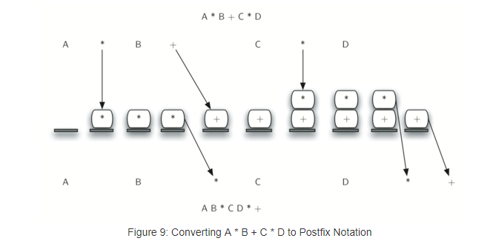
Infix-to-Postfix Conversion
The conversion algorithm working on the expression A * B + C * D. Note that the first * operator is removed upon seeing the + operator. Also, + stays on the stack when the second * occurs, since multiplication has precedence over addition. At the end of the infix expression the stack is popped twice, removing both operators and placing + as the last operator in the postfix expression.

Slide 17
Infix to Postfix Conversion
A * B + C
Symbol Stack Postfix String
A A
* * A
B * AB
+ + AB*
C + AB*C
AB*C+

Slide 18
Infix to Postfix
A+B*C
A*(B+C)
A-B+C
A*B^C+D
A*(B+C*D)

Slide 19
Infix to Postfix
A+B*C = ABC*+
A*(B+C) = ABC+*
A-B+C = AB-C+
A*B^C+D =ABC^*D+
A*(B+C*D) = ABCD*+*

Slide 20
Infix to Prefix
When you are pushing the operator onto the stack, you have to check the following
If stack is empty, you can push the operator
If stack has some operators into it, and if the precedence of the operator in the stack is low, then the new operator can be pushed, else, pop the operators from the stack until the precedence of the operator in the stack is low.
If the precedence is same, check the associativity of the precedence, if it is L->R, then push the new operator onto the stack, else, pop from the stack.

Slide 21
Infix to Prefix Conversion
A + B * C + D
Write the reverse : D + C * B + A
Reverse : ++A*BCD
Infix Expression | Stack | Prefix Expression
D |  | D
+ | + | D
C | + | DC
* | +* | DC
B | +* | DCB
+ | ++ | DCB*
A | ++ | DCB*A
 |  | DCB*A++

Slide 22
Exercises
(A+B)*(C+D)
A*B+C*D
A+B+C+D

Slide 23
Infix to Prefix
(A+B)*(C+D) = *+AB+CD
A*B+C*D = +*AB*CD
A+B+C+D = +++ABCD

Slide 24
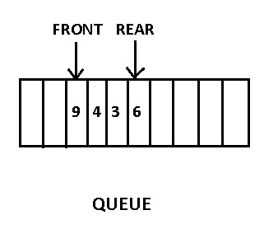
Queues
A queue is an ordered list in which all insertions take place at one end, the rear, while all deletions take place at the other end, the front.
Queue is a First-In-First-Out ( FIFO ) type data structure i.e the element which is added first will be removed first.

Slide 25
Operations on Queues
Queue operations may involve initializing or defining the queue, utilizing it, and then completely erasing it from the memory. Basic operations associated with queues are −
enqueue() − add (store) an item to the queue.
dequeue() − remove (access) an item from the queue.
Few more functions are required to make the above-mentioned queue operation efficient. These are −
peek() − Gets the element at the front of the queue without removing it.
isfull() − Checks if the queue is full.
isempty() − Checks if the queue is empty.
In queue, we always dequeue (or access) data, pointed by front pointer and while enqueing (or storing) data in the queue we take help of rear pointer.

Slide 26
Enqueue Operation
Queues maintain two data pointers, front and rear. Therefore, its operations are comparatively difficult to implement than that of stacks.
The following steps should be taken to enqueue (insert) data into a queue −
Step 1 − Check if the queue is full.
Step 2 − If the queue is full, produce overflow error and exit.
Step 3 − If the queue is not full, increment rear pointer to point the next empty space.
Step 4 − Add data element to the queue location, where the rear is pointing.
Step 5 − return success.

Slide 27
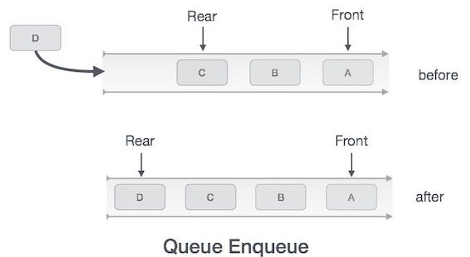

Slide 28
Dequeue Operation
Accessing data from the queue is a process of two tasks − access the data where front is pointing and remove the data after access. The following steps are taken to perform dequeue operation −
Step 1 − Check if the queue is empty.
Step 2 − If the queue is empty, produce underflow error and exit.
Step 3 − If the queue is not empty, access the data where front is pointing.
Step 4 − Increment front pointer to point to the next available data element.
Step 5 − Return success.

Slide 29
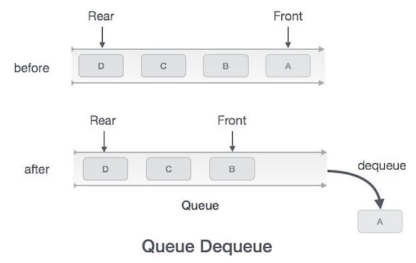

Slide 30
Types of Queues
1. Deque
2. Circular Queue
3. Priority Queue

Slide 31
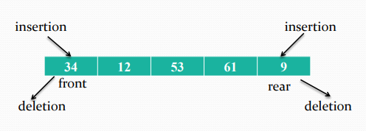
DEQUES
Deque stands for double ended queue.
Elements can be inserted or deleted at either end.
Also known as head-tail linked list.

Slide 32
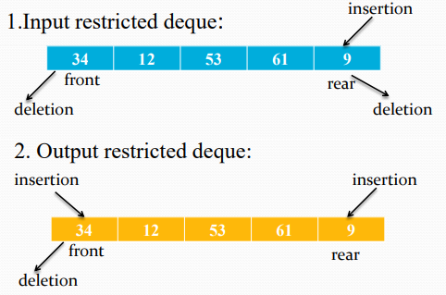
Types Of Deque

Slide 33
Circular queues
The Regular, static queues in data structures have a very big drawback, that once the queue is FULL, even though we delete few elements from the “front” and relieve some occupied space, we are not able to add anymore elements, as the “rear” has already reached the queue’s rear most partition.
To overcome this drawback we can implement the queue as a circular queue. Here as we go on adding elements to the queue and reach the end of the array, the next element is stored in the first slot of the array (provided it is free).
As the name suggests, this queue is not straight but circular.
Thus, Circular Queue is the most common practical implementation of the queue data structure. If the queue size is limited ( when array based implementation is used ), we can insert elements towards the beginning of the queue ( if there is space ) when we reach the maximum limit at the rear end.

Slide 34
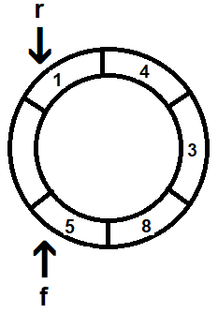
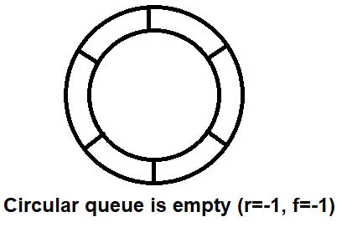
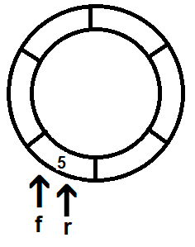
Initially when such a circular queue is empty ,the “Front” and the “rear” values are-1 and -1 respectively; and the queue has a null value for all the elements.
Every time we add an element to the queue the “rear” value increments by 1 till the time it reaches the upper limit of queue; after which it starts all over again from’0’
Similarly, every time we delete an element from queue, the “front” value increments till the time it reaches the upper limit of queue. After which it starts all over again from ‘0’.

Slide 35
Application of a linear queue.
Queue is useful in CPU scheduling, Disk Scheduling. When multiple processes require CPU at the same time, various CPU scheduling algorithms are used which are implemented using Queue data structure.
When data is transferred asynchronously between two processes. Queue is used for synchronization. Examples : IO Buffers, pipes, file IO, etc.
In print spooling, documents are loaded into a buffer and then the printer pulls them off the buffer at its own rate. Spooling also lets you place a number of print jobs on a queue instead of waiting for each one to finish before specifying the next one.
Breadth First search in a Graph. It is an algorithm for traversing or searching graph data structures. It starts at some arbitrary node of a graph and explores the neighbor nodes first, before moving to the next level neighbors. This Algorithm uses Queue data structure.

Slide 36
Linked Lists
A linked list is a sequence of data structures, which are connected together via links.
Linked List is a sequence of links which contains items. Each link contains a connection to another link. Linked list is the second most-used data structure after array. Following are the important terms to understand the concept of Linked List.
Link − Each link of a linked list can store a data called an element.
Next − Each link of a linked list contains a link to the next link called Next.
LinkedList − A Linked List contains the connection link to the first link called First.

Slide 37
Types of Linked List
Following are the various types of linked list.
Singly Linked List − Item navigation is forward only.
Doubly Linked List − Items can be navigated forward and backward.
Circular Linked List − Last item contains link of the first element as next and the first element has a link to the last element as previous.

Slide 38
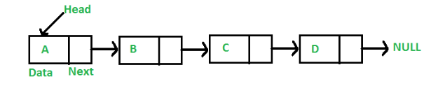
Singly linked lists
A linked list is a linear data structure, in which the elements are not stored at contiguous memory locations. The elements in a linked list are linked using pointers as shown in the below image:
In simple words, a linked list consists of nodes where each node contains a data field and a reference(link) to the next node in the list.

Slide 39
Basic Operations of singly linked list:
Insertion − Adds an element at the beginning of the list.
Deletion − Deletes an element at the beginning of the list.
Display − Displays the complete list.
Search − Searches an element using the given key.
Delete − Deletes an element using the given key.

Slide 40
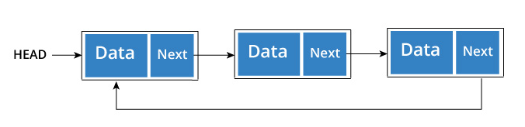
Circularly linked lists
Circular Linked List is a variation of Linked list in which the first element points to the last element and the last element points to the first element. Both Singly Linked List and Doubly Linked List can be made into a circular linked list.

Slide 41
A circular linked list can be either singly linked or doubly linked.
for singly linked list, next pointer of last item points to the first item
In doubly linked list, previous pointer of first item points to last item as well.
Basic Operations of Circular Linked List are as follows:
insert − Inserts an element at the start of the list.
delete − Deletes an element from the start of the list.
display − Displays the list.

Slide 42
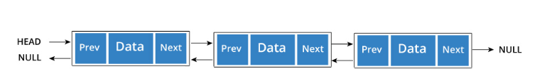
Doubly Linked List
Doubly Linked List is a variation of Linked list in which navigation is possible in both ways, either forward and backward easily as compared to Single Linked List.

Slide 43
Following are the important terms to understand the concept of doubly linked list.
Link − Each link of a linked list can store a data called an element.
Next − Each link of a linked list contains a link to the next link called Next.
Prev − Each link of a linked list contains a link to the previous link called Prev.
LinkedList − A Linked List contains the connection link to the first link called First and to the last link called Last.

Slide 44
Basic Operations of doubly linked lists
Insertion − Adds an element at the beginning of the list.
Deletion − Deletes an element at the beginning of the list.
Insert Last − Adds an element at the end of the list.
Delete Last − Deletes an element from the end of the list.
Insert After − Adds an element after an item of the list.
Delete − Deletes an element from the list using the key.
Display forward − Displays the complete list in a forward manner.
Display backward − Displays the complete list in a backward manner.

Slide 45
Polynomial addition
Addition of two polynomials implemented by linked list.
It requires comparing the exponents, and wherever the exponents are found to be same, the coefficients are added up.
For terms with different exponents, the complete term is simply added to the result thereby making it a part of addition result.
The complete program to add two polynomials is given in subsequent section.

Slide 46
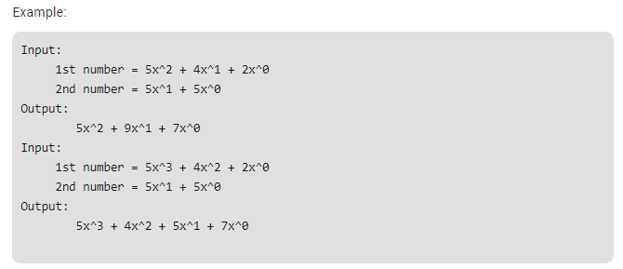
Example
Given two polynomial numbers represented by a linked list. Write a function that add these lists means add the coefficients who have same variable powers.

Slide 47
